Slide 1
Skyhack 2.0 Hackathon
Organised By : United Airlines
Submission By : Meetali Madhusmita, Yashi Sharma
Department of Computer Science
University of Delhi

Slide 2


DELIVERABLES
Key drivers of Long AHT and AST
Recurring self-solvable issues
Improving operational efficiency

Slide 3



Combining dataframes
Merged different datasets provided in the hackathon
Missing Values
Understanding the DATA
Since a small percentage of data had missing values, dropped the records
Pre-Processing
Removing duplicates, primary_call_reasons needed formating, encoding categorical features
Feature Engineering
Deriving important features, from the ones given in dataset

Slide 4
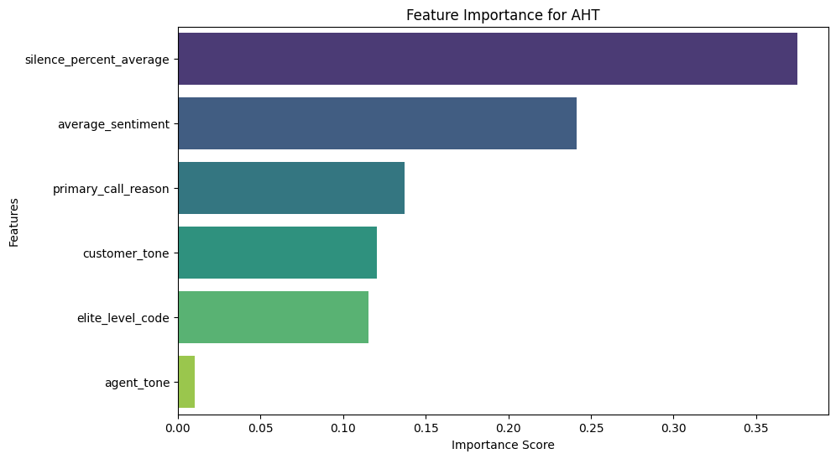
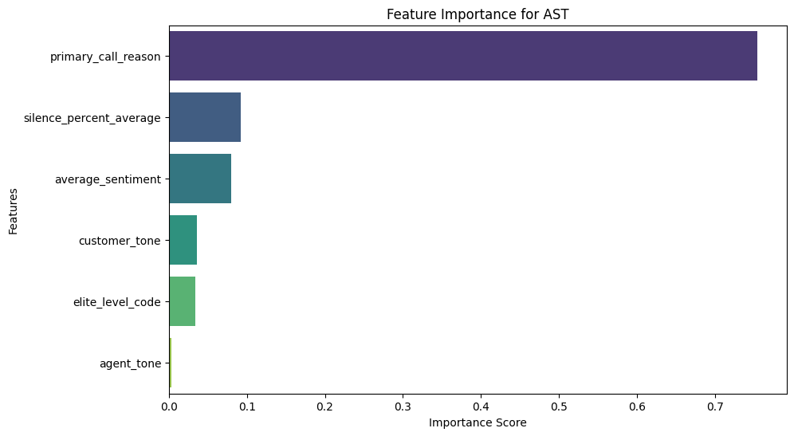
Key drivers of AHT and AST
AHT (Average Handle Time): 11.61 seconds
AST(Average Speed to Answer): 7.28 seconds

Slide 5
Solutions for long AHT and AST
Our analysis shows that silence during the call is one of the major factors of AHT. In order to reduce silence during calls agents can be provided with a large knowledge base which helps them to answer quickly.
Another reason for long silence can be a lack of experience with the nature of the complaint. One solution is to direct the calls to agents with experience dealing with similar issues that they have handled in the past.
A dashboard can be generated with performance metrics displaying the agent's score. If any agent's performance is below the acceptable threshold value, the system will inform the manager.

Slide 6
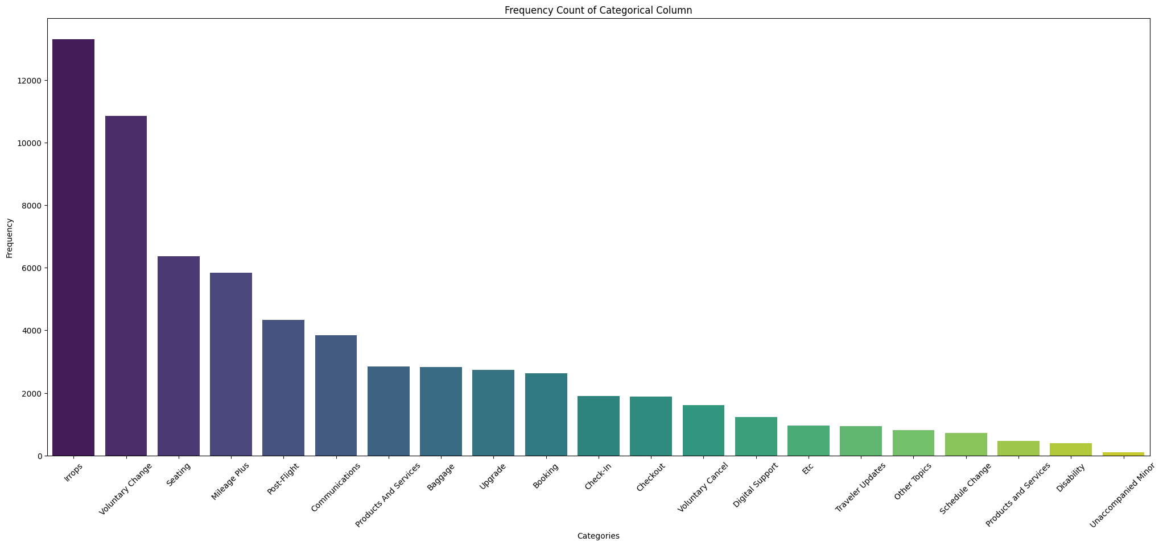
PERCENTAGE DIFFERENCE BETWEEN AHT FOR
MOST FREQUENT AND LEAST FREQUENT CALL REASONS
MOST FREQUENT : IRROPS
LEAST FREQUENT : UNACCOMPANIED MINOR
Percentage Difference : 51.20%

Slide 7

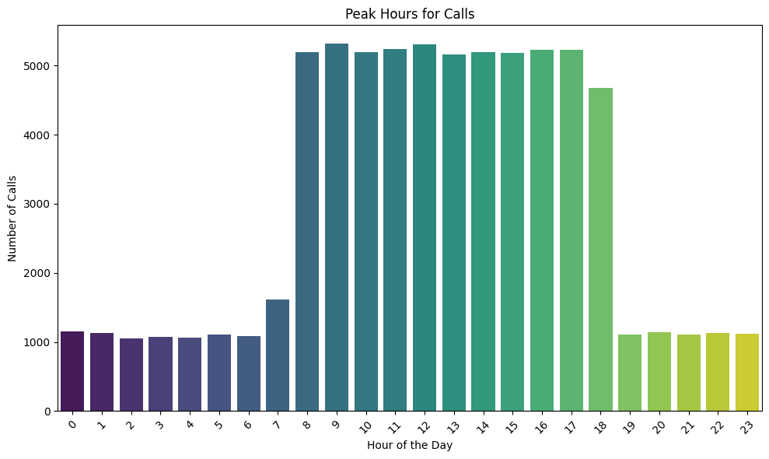
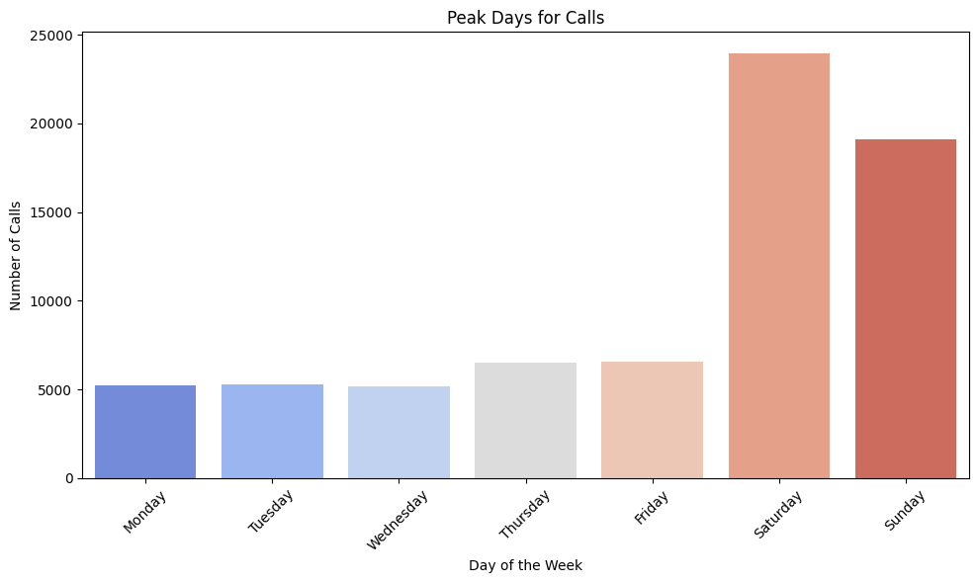
RECURRING SELF-SOLVABLE ISSUES
After analysing primary_call_reason column, we found IRROPS is the most recurrent issue while Unaccompained Minor is the least frequent issue. Also data analysis shows that Saturday and Sunday are the busiest days and peak hours ranges from 8 AM to 6 PM.

Slide 8

SUGGESTIONS TO IMPROVE IVR SYSTEM
1. Enhance User Experience : Adding guides and tutorials to the website will help users easily find information, making their navigation smoother and simpler.
2. Addressing Challenges: Topics like Communications, "Etc.," and Other Topics pose unique challenges due to their broad and vague nature, making them difficult to cover under the IVR system.
3. Implement a Chatbot: A chatbot on the home screen can efficiently handle FAQs and quick queries, reducing the call center's workload and allowing customers to get the answers they need in a flash!

Slide 9
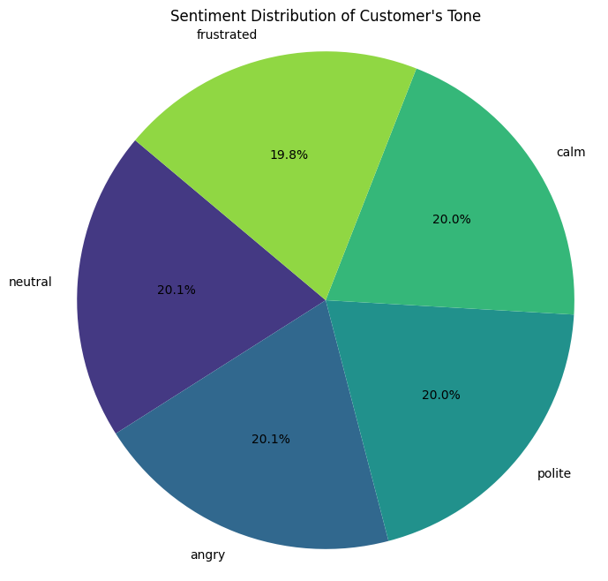
IDENTIFYING PRIMARY REASONS FOR INCOMING CALLS
We analyzed the dataset to determine the percentage of customers exhibiting negative emotions versus those displaying positive emotions.
This analysis led us to conclude that approximately 40% customers are detected with negative emotions while 60% of them were polite, calm, or neutral
during the conversation.

Slide 10


Processing Call Transcripts
Breaking down the conversation into agent_transcript and customer_transcript
Removing stopwords, and extracting the top keywords
Using random forest
for training and testing.
Achieving 19% accuracy

Slide 11
APPROACH
1. TF-IDF + Logistic Regression: Achieved an accuracy of 0.05% due to time constraints.
2. Random Forest: Reached an accuracy of 19%.
3. Other Algorithms: KNN and XGBoost Classifier were attempted but could not yield timely results.
4. BERT-based Embeddings: Attempted to use BERT but couldn’t process outputs due to time limitations and the long processing time per epoch.
5. Topic Modeling: Could have been a valuable alternative for enhancing our analysis and improving accuracy.

Slide 12
For classification, rather than using only call_transcripts for prediction, structured features can be used as well.
Using other robust models for natural language processing like BERT will yield better results.
Future Work
Topic modeling to cluster call reasons more effectively. Understanding the root causes behind calls will allow further refinement of the IVR to ensure fewer calls are escalated to agents.
Integrate CRM systems, and customer feedback loops into the analysis to develop a more comprehensive view of why customers call and how IVR systems can be further customized

Slide 13

Thank you!

